Slide 1
Welcome to the experiment!
First we will give you some instructions and begin with some practice blocks to help familiarise yourself with the tasks.
Please press any key to continue…

Slide 2

You will be presented a screen like this and you will be asked to stare at the
cross in the centre. Some of the time you will be looking at this cross and
not moving your eyes at all! (Maintaining fixation).
You will see a white circle appear around the cross on a lot of trials that will
indicate that this is an eye-movement trial! On these trials you will need to
make an eye-movement to a specific location (indicated by an arrow) at the
sound of a beep. You should make your eye-movement your main priority!
At the end of each trial, you will be asked to say whether you
saw an E or a Ǝ at one of the 4 locations. So for example, in this image, the
correct answer is a Ǝ. You would indicate this with a left arrow at the end of
the round. You always choose the direction that the E or Ǝ is facing as your
response. The other 2s and 5s are distractors.
Press any key to continue…

Slide 3
The most important task is making sure that your eye-movements are quick and accurate and that they land at the intended location as soon as you hear the beep. You may also see an arrow on trials without a circle or a beep. Try your best to maintain fixation on these trials because otherwise they will have to be removed from the dataset.
Mixed in with these eye-movement trials will be regular trials where you should just maintain fixation at the centre. We will do some practice trials now and afterwards you can discuss any questions/concerns with the researcher.
You may see some other things on the screen that have not been discussed here. They will not impact your responses in any way.
Press any key to begin the practice experiment!

Slide 4
You will now practice making eye movements to the correct location as quickly as possible.
Please prepare your eye movements in the direction that the arrow points. At the sound of the beep, perform your eye movement as quickly and accurately as possible! We are aiming to keep this as accurate and consistent as possible. You will not need to make any response on these trials, just focus on the eye movement.

Slide 5
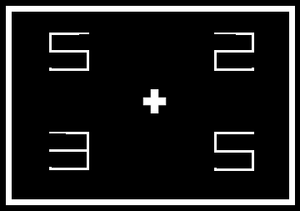
You will now put both of those skills together and practice them.
You will now see the circle on some trials, indicating that you should
make an eye movement.
And no circle on other trials, indicating that you should maintain
fixated at the centre of the screen and ignore the arrow.
But for both types of trial, you will need to make the same decision
about whether you saw an E or a Ǝ

